Slide 1
So Do I / Neither Do I
To agree and not to agree
Arranged by
Rozanah Katrina Herda, S.Pd.,M.Pd

Slide 2
Affirmative
I live in Indonesia. Where do you live?
So do I I also do.
So does he She also does.
I do too.
She does too.

Slide 3
Emily likes chocolate and...
So do I I also do.
So does Yosa Yosa also does.
I do too.
Yosa does too.

Slide 4
I am a good person
So are you You are too
So am I I am too
So is Alvaro Alvaro is too

Slide 5
Steven is going to be happy.
So am I I am too
So is she She is too
So are they They are too

Slide 6
I was here last Monday
So was I. I also was. I was too.
So were you. You also were. You were too.
Christopher and I traveled to England.
So did they. They also did. They did too.
So did I. I also did. I did too.

Slide 7
I will travel in Summer.
So will the boy. He also will. He will too.
So will the children. They also will. They will too.
They would like to eat now.
So would the cat. It also would. It would too.
So would you. You also would. You would too.

Slide 8
You have already written.
So have we. We also have. We have too.
So has he. He also has. He has too.
Can – May – Might – Should - Could...

Slide 9
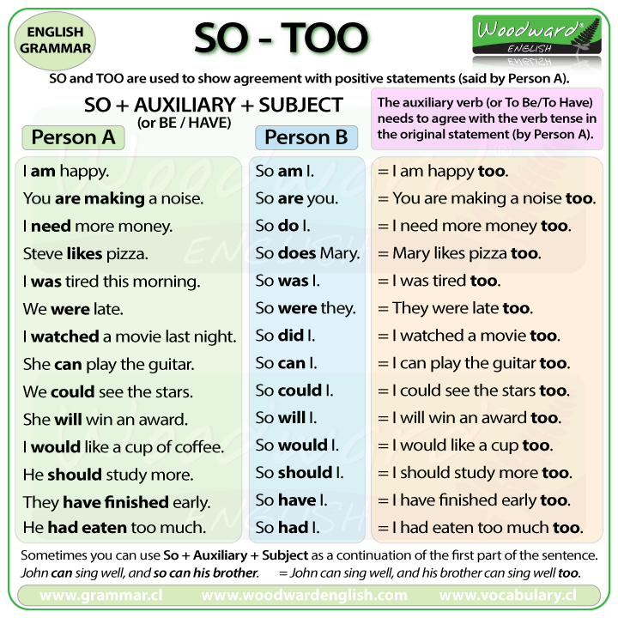


Slide 10
Negative
I don’t like yellow.
Neither do I. I don’t either.
Nor does she. She doesn’t either.
do they
Neither = not either

Slide 11
Eggy isn’t tired...
Neither am I. I am not either.
is she. She isn’t either.
She wasn’t ok, and...
Neither was he. He wasn’t either.
were we. We weren’t either.

Slide 12
You didn’t live in New Jersey.
Neither did you. You didn’t either.
Ronald. He didn’t either.
Victoria won’t travel to Sidney.
Neither will I. I won’t either.
Phill. Phill won’t either.

Slide 13
I can’t talk with you now.
Neither can I. They can’t either.
We couldn’t live in Alaska.
Neither could he. He couldn’t either.
I never eat onions.
Neither do I. I don’t either.

Slide 14
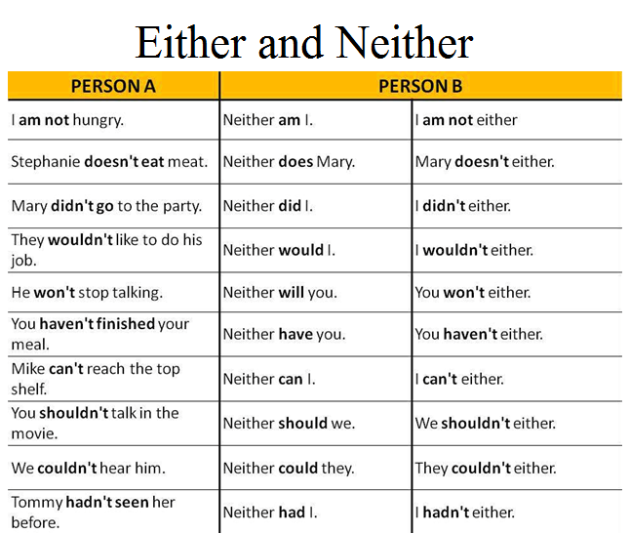

Slide 15
